Slide 1
Continuing Professional Development for Teacher-Educators CPDC Introduction to Educational Technology CPDC Development Team
In association with the National Commission for Colleges of Education, Abuja
August 2015

Slide 2
Overview
Who are we?
What is the module about?
What are the assessment tasks?

Slide 3
Who are we?
Overview of CPDC Edutech

Slide 4
Educational Technology
Break into pairs.
Each member of the pair should interview his/her colleague to find out:
His/her name
His/her subject(s)
His/her most meaningful teaching or learning experience.
When ready, each member of the pair introduces his/her partner to the rest of the group.

Slide 5
What do you expect from this module?
Overview of CPDC Edutech

Slide 6
Warm-up
Brainstorm in groups and suggest some technological equipment and materials you think is relevant in teaching and learning in your various disciplines.
Mention the types of educational technology equipment/materials your own teachers used while you were students.
Discuss some of the Educational technology equipment and materials you regularly as a teacher educator.
Now try to group them in some way.
Discuss any differences between experience and practice.

Slide 7
Educational Technology
Content
This module comprises an introduction and five units.
Selection of appropriate educational technology for different class situations
Selection of appropriate educational technology for different class needs
Utilizing mobile learning technology for instruction
Accessing Open Educational Resources (OER) using Educational Technology for Instruction.
Challenges that come with developing and using educational technology materials
All based on practical examples

Slide 8
Educational Technology as a means of enhancing learning
Group discussion
What are the key features of educational technology equipment/materials?
What are the benefits of using educational technology inside the classroom?
How can the use of educational technology materials enhance effective learning?
Can Educational Technology replace the teacher in the classroom?

Slide 9
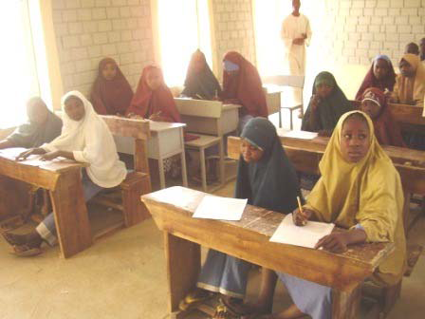
Traditional / Modern approach in teaching

Slide 10
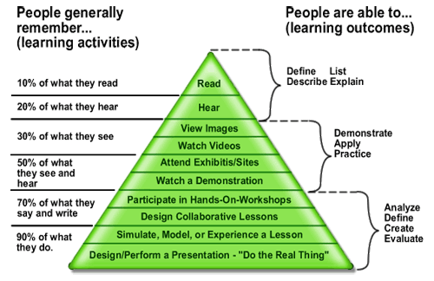
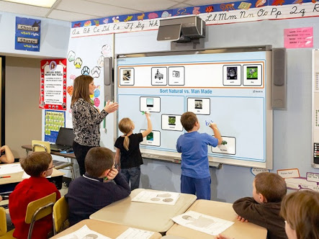
Cone of experience

Slide 11
Educational Technology in the curriculum
What is the Curriculum saying on the use of Educational Technology with regards to needs and environment?
What is the scope of Educational technology in the curriculum?

Slide 12
Rethinking Educational technology (1)
Selecting the appropriate educational technology depends on the topics, needs and situation.
Teacher Educators need to acquires the skills to effectively utilize mobile learning technology to support more engaged learning.
There is need to enhance the ability of teacher-educators to access Open Educational Resources (OER) using Educational Technology to support more effective learning.

Slide 13
Rethink Educational Technology (2)
Teacher-educators should develop the skills of improvisation.
There is need to support teacher-educators to overcome challenges that come with developing and using educational technology materials.
Knowledge in learning a particular skill influences the learners’ thought to develop creative ability, muscle control, and appreciation of good craftsmanship towards the use of a particular medium. The Nigeria Educational Research and Development Council (NERDC, 2007).

Slide 14
Modern perspective
People learn better when multimedia messages are designed in ways that are consistent with how the human mind works and with research-based principles (Mayers 2003)

Slide 15
So …
The use of instructional materials in meeting the challenges of learning to ensure better academic performance of students should not be underscored. Students learn better when adequate instructional media and materials are designed, produced and packaged to complement teacher’s effort (Ajayi-Dopemu, 1989).
what I am told, I forget; what I see, I remember; what I do, builds castles in my mind” (Nkuuhe et al, 1995).

Slide 16
What are the assessment tasks?
Overview of CPDC Educational Technology

Slide 17
Assessment tasks
Reflect on prior knowledge and experience
Summarise current theory and practice
Integrate educational technology into both well- and under-resourced learning environments
Competency-based assessment rubric

Slide 18
Any final questions?
Selection of appropriate educational technology for different class situations.
Selection of appropriate educational technology for different class needs.
Utilizing mobile learning technology for instruction
Accessing Open Educational Resources (OER) using Educational Technology for Instruction.
Challenges that come with developing and using educational technology materials
Try to complete the first two units and email me the first assignment at: XXX@XXX
Before we meet again on: XXXXXX

Slide 19
Thank you for participating

